Slide 1
Data Analytics using Python – UK COVID-19 data
Presented by Haroon Miah

Slide 2
Scenario/Overview
UK government would like us to analyse COVID-19 data (from January 2020 to October 2021).
As part of its goal to increase the number of fully vaccinated individuals (people who have received a first and second dose of the vaccine), the government is planning to launch a series of marketing campaigns to promote the vaccine.
The government wants to identify trends and patterns that can be used to inform its marketing approach.

Slide 3
Expectations/Objectives
The government would like to know:
First dose, second dose per region, total and overtime
Where they should target their first marketing campaign(s) based on:
area(s) with the largest number of people who have received a first dose but no second dose
which area has the greatest number of recoveries so that they can avoid this area in their initial campaign runs
whether deaths have been increasing across all regions over time or if a peak has been reached.
What other types of Twitter data points and tweets have both #coronavirus and #vaccinated hashtags.
Demonstrate using external function and interpret results for Hospitalised data.

Slide 4
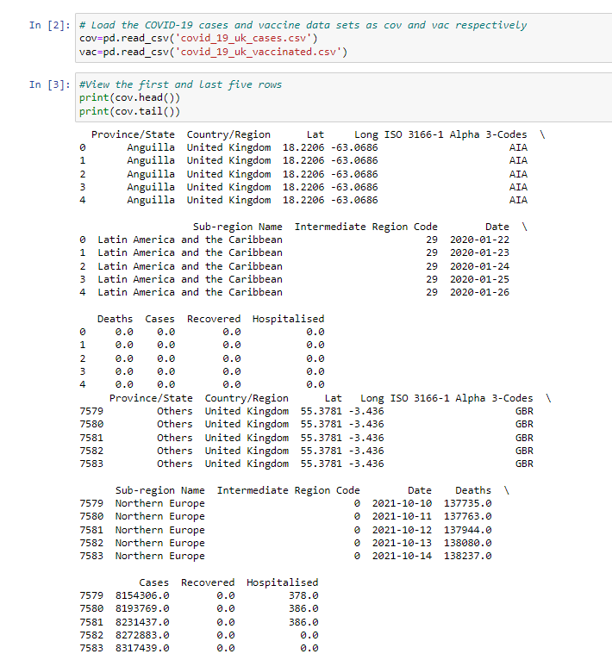
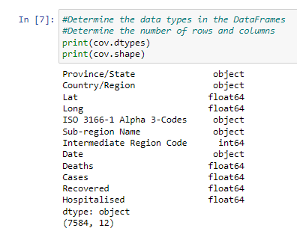
Notes:
Import the covid cases csv and view head, tail and data types

Slide 5
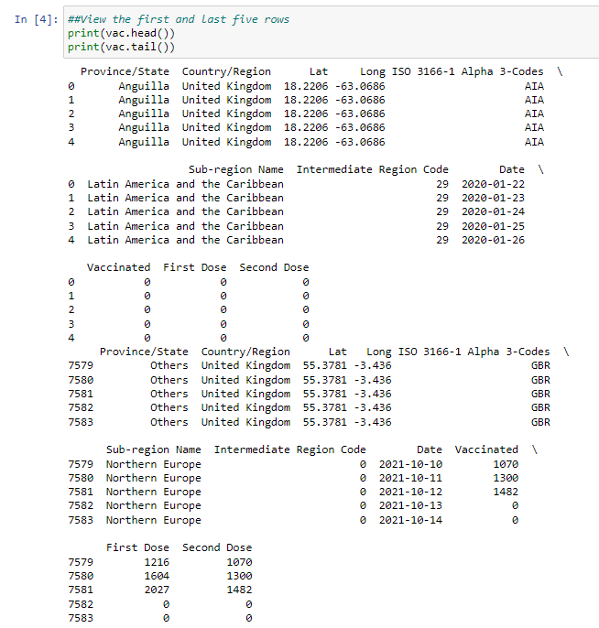
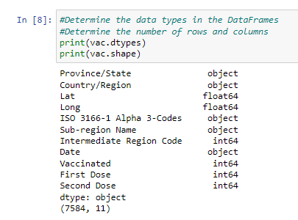
Notes:
Import the vaccine numbers csv and view head, tail and data types

Slide 6
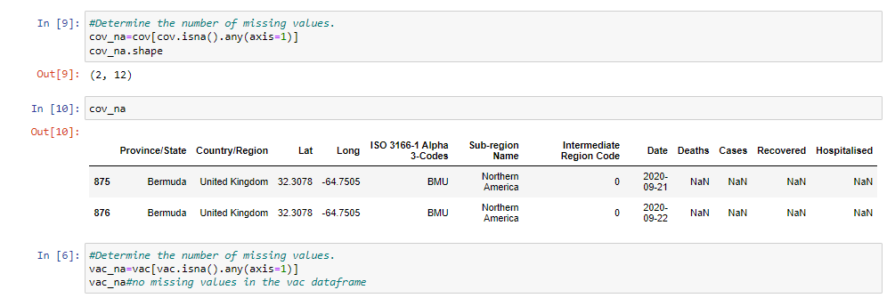
Notes:
Identify any missing values in the 2 datasets

Slide 7
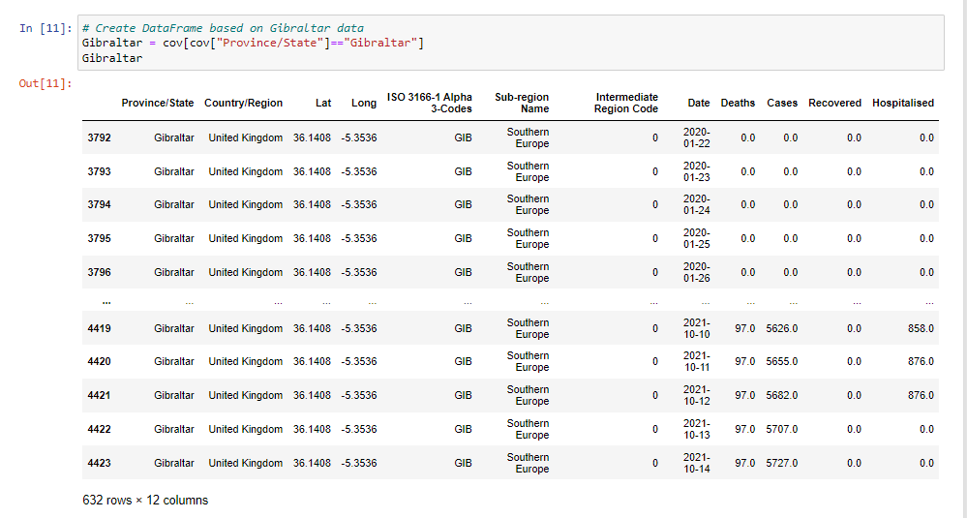
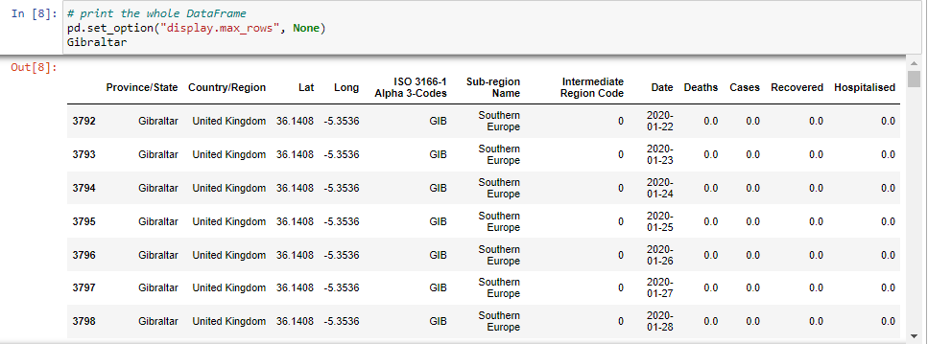
Notes:
Create a data frame with only the data for Gibraltar; using cov dataset

Slide 8
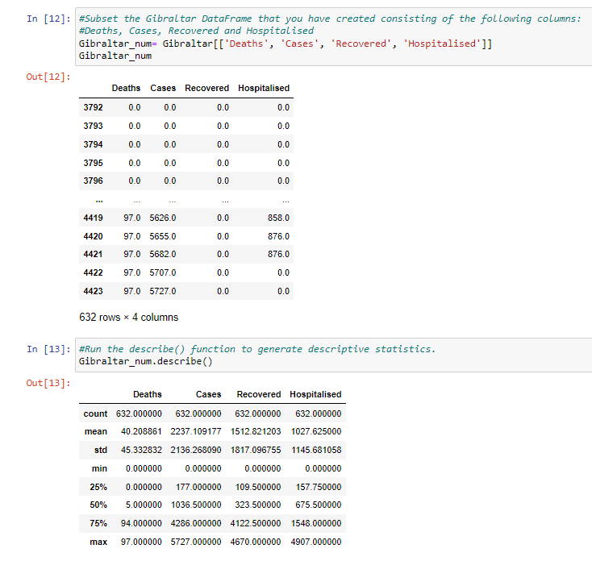
Notes:
Run Descriptive statistics

Slide 9
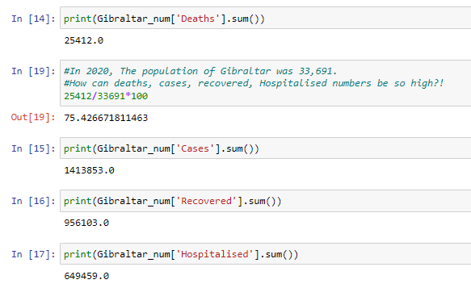
Notes:
and sums for the numeric fields

Slide 10
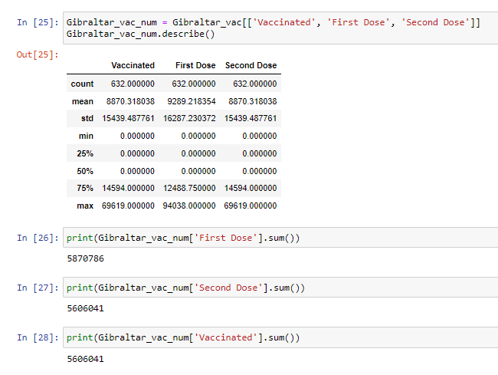
Notes:
Same for the vaccinated numbers

Slide 11
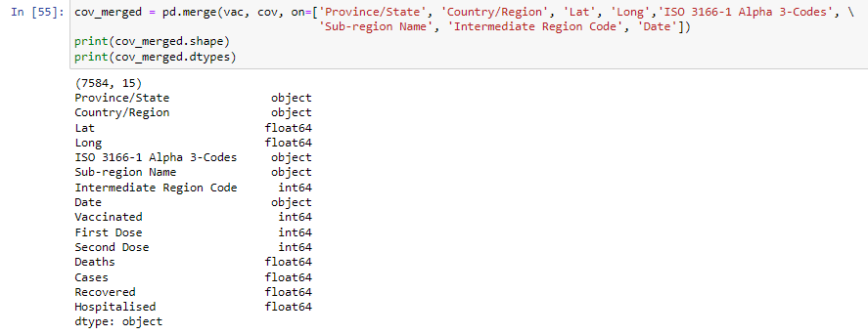
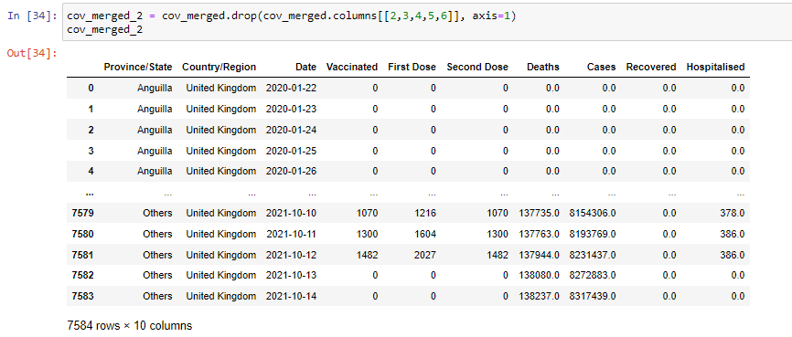
Notes:
Merge the cov and vac data frames to create one big dataset with everything in one place. Keeping only the columns that we need for analysis

Slide 12
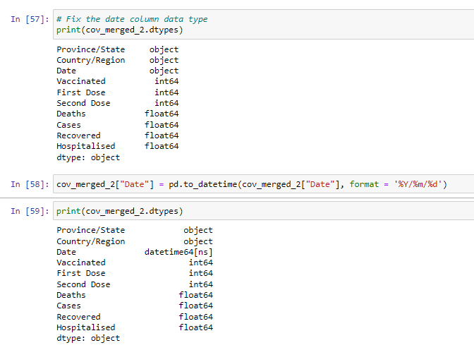
Notes:
Convert the ‘Date’ field to date format (initially it is ‘object’)

Slide 13
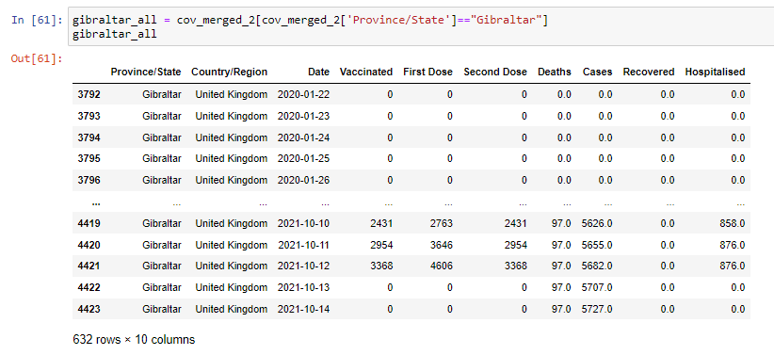
Notes:
Create a subset with Gibraltar data only again (using the merged data frame).

Slide 14
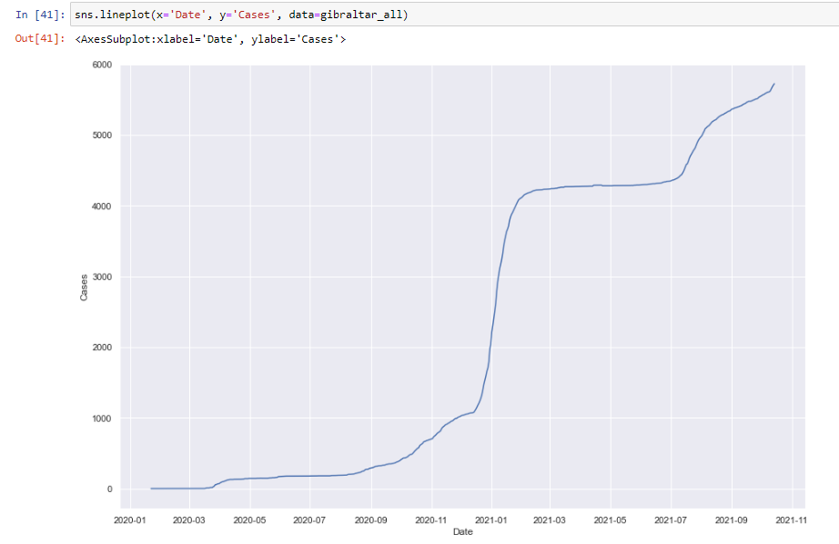
Notes:
Line plot of cases over time with the Gibraltar data

Slide 15
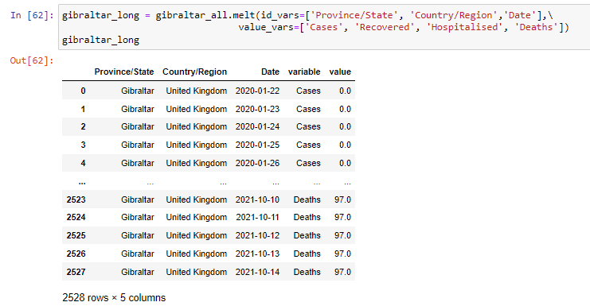
Notes:
Use the ‘melt()’ function to mutate the Gibraltar data and have all the values in one field and the corresponding variable. This will allow us to plot a line plot with cases, deaths etc in one graph

Slide 16
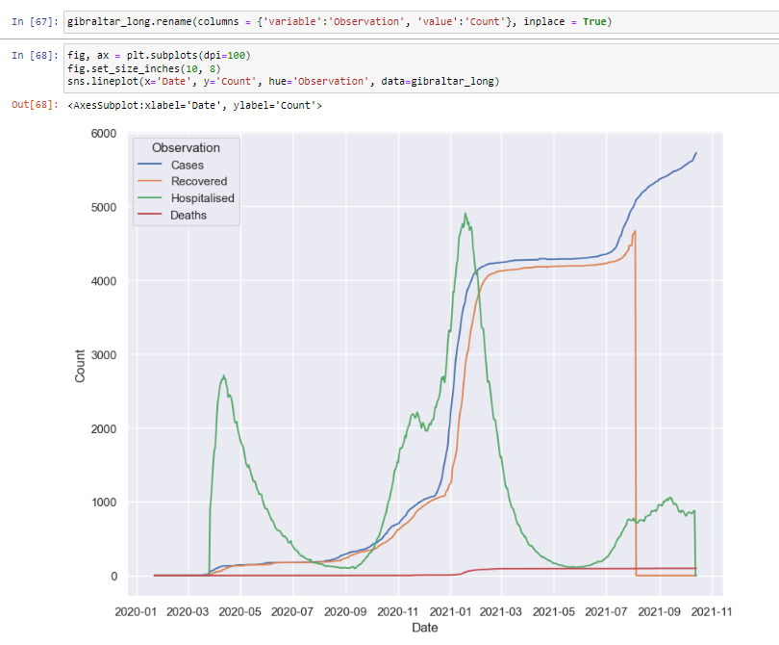
Notes:
This clearly shows what was mentioned earlier about irregularities with the dataset; how can hospitalised cases be higher than the number of Covid cases at any given timepoint? There is a steep drop in the number of recovered cases at one point; shouldn’t the number of deaths increase at around the same time?

Slide 17
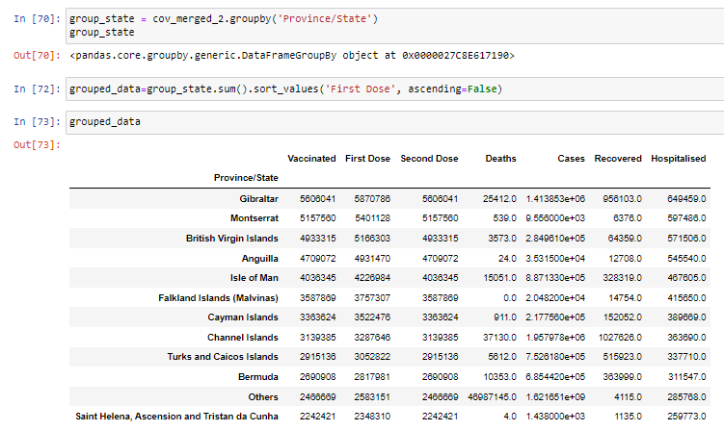
Notes:
Group data by Province/State, then aggregate the variables to show the sum for each. The State that has received the highest number of First Doses is Gibraltar

Slide 18
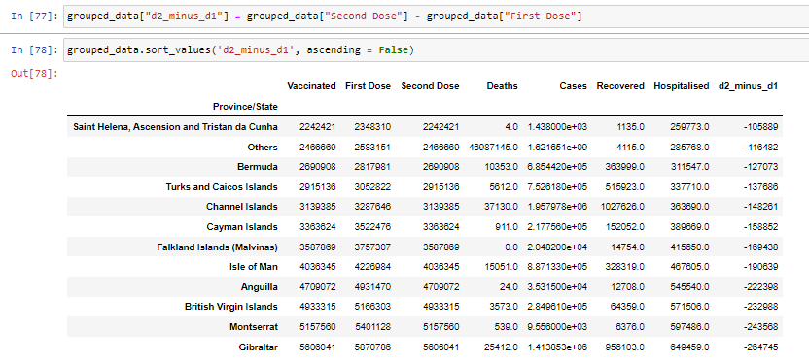
Notes:
Now you can calculate the difference between first and second dose.

Slide 19
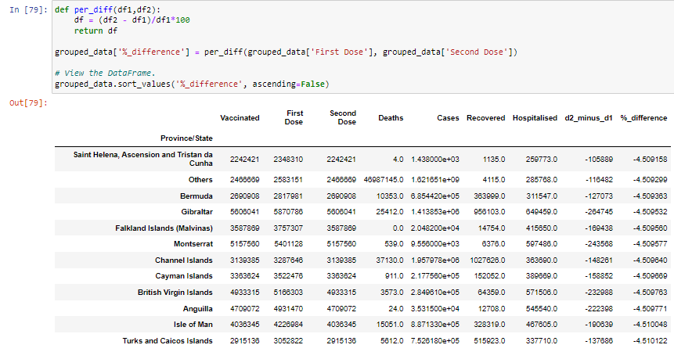
Notes:
Used a function to work out the % difference between First Dose and Second Dose. The State that has the highest percentage who have received the first dose but not the second dose is, ‘Saint Helena, Ascension and Tristan da Cunha’ and so this could be a State for the government to target to boost fully vaccinated numbers.

Slide 20
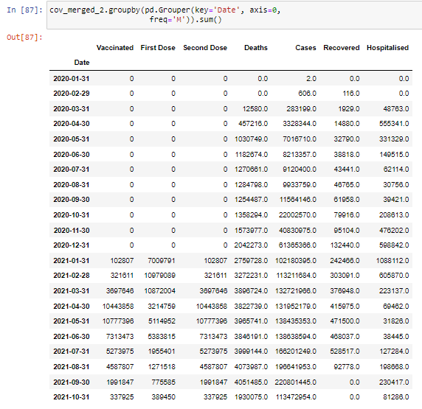
Notes:
This shows us that the number of vaccinated individuals goes up from Jan 2021 to May 2021 but then we see a fall thereafter. With the first dose numbers, there are fluctuations throughout the entire timeframe but in general we see that there is a decline in the numbers being vaccinated towards the end of time. We can also note that, around April/May 2021 there are drops in the number of hospitalised in the corresponding months (April to June 2021); this could be due to the positive effects of the vaccine and so fewer people required hospitalisations.

Slide 21
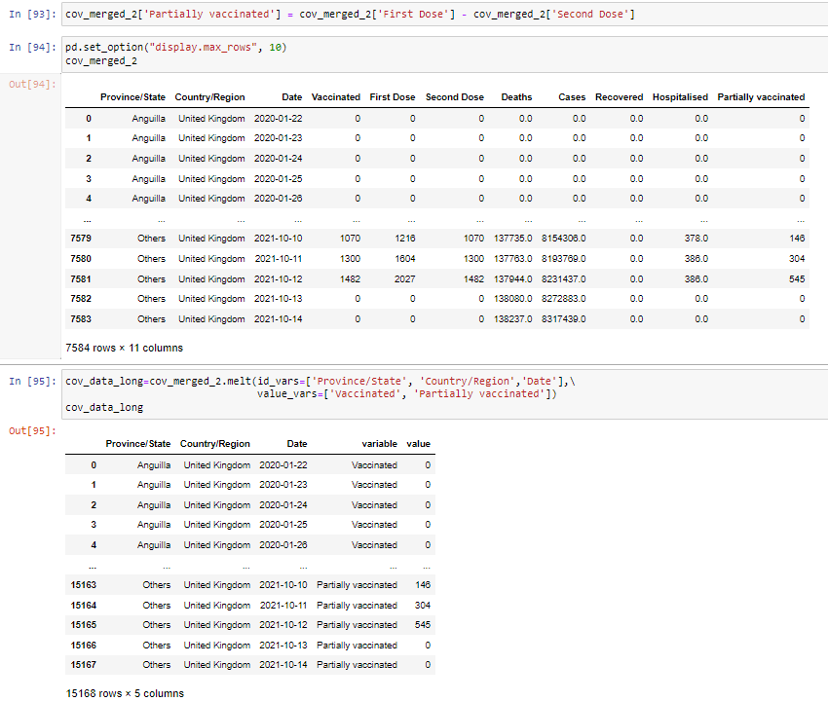
Notes:
Work out Partially vaccinated by subtracting the Second Dose number from the First Dose numbers. Use the melt function again to have the partially vaccinated and ‘Vaccinated’ variable in one column and then the values in the next column. Now we can plot these.

Slide 22

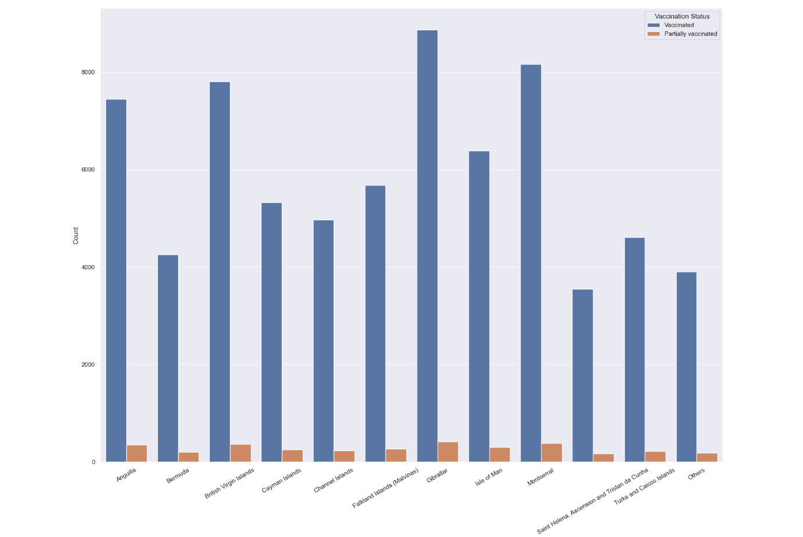
Notes:
Bar plot to show the number for Fully Vaccinated and Partially vaccinated for each state in one plot.

Slide 23
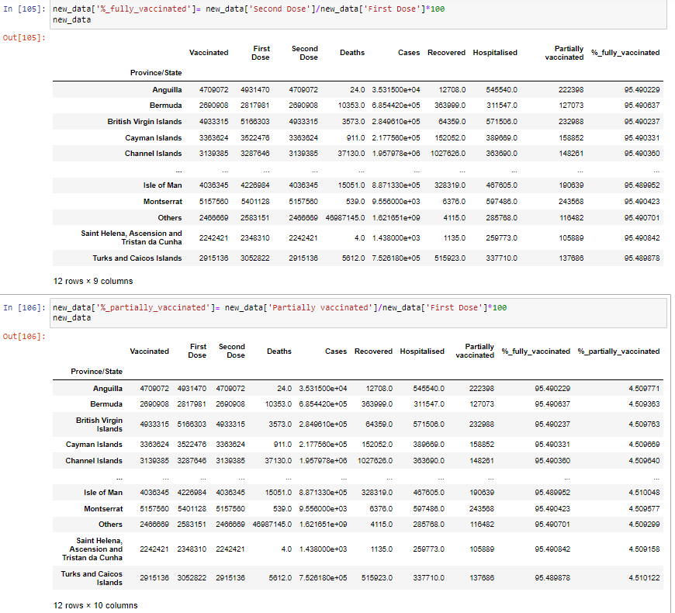
Notes:
Calculate percentages for fully and partially vaccinated for all states.

Slide 24
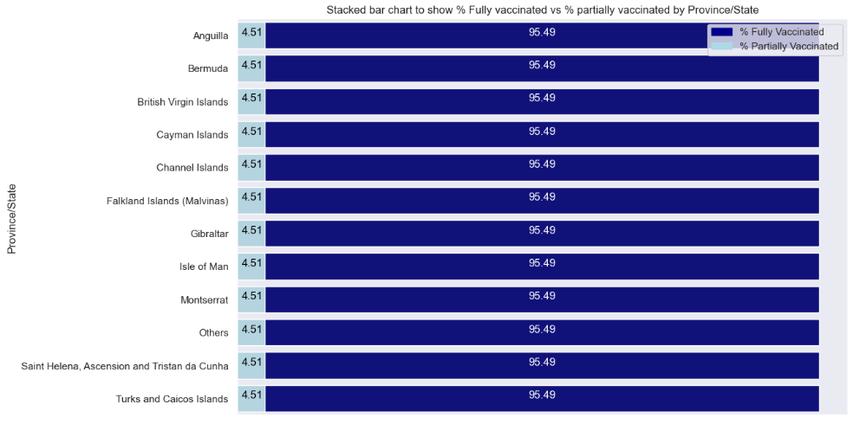
Notes:
All states had the same % for fully and partially vaccinated; something not right

Slide 25
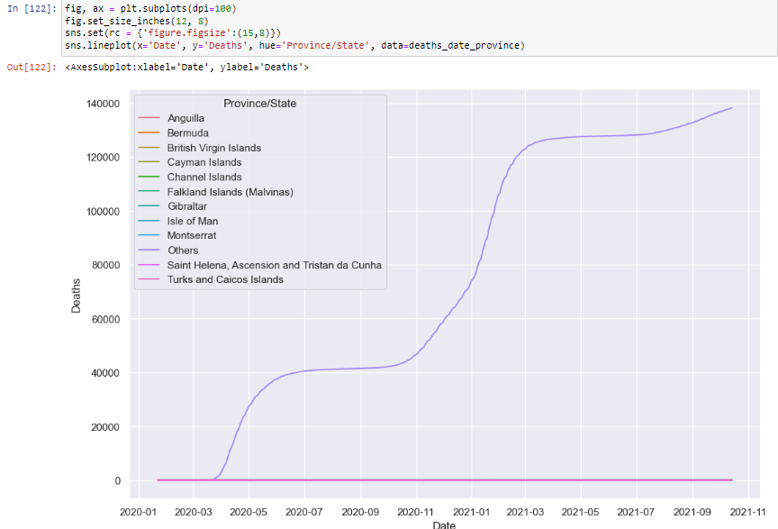
Notes:
Group data by Province and Date then plot the deaths over time. Something not right.

Slide 26
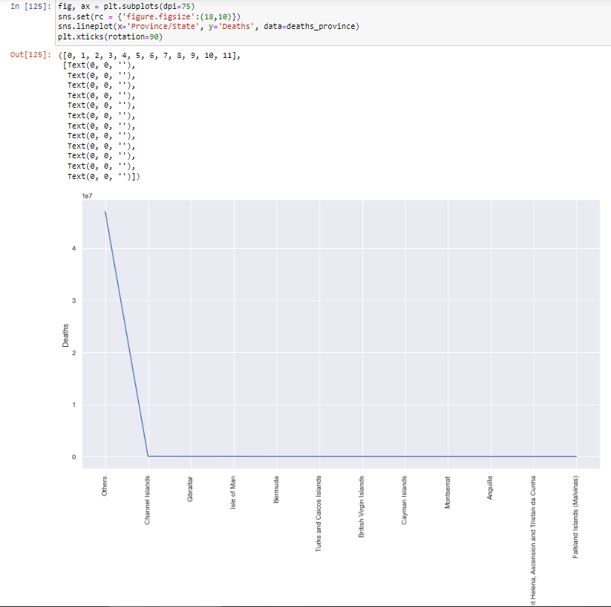
Notes:
Group the data by Province/State aggregating the death count to determine which Province/State causes the data set to be skewed; ‘Others’!

Slide 27
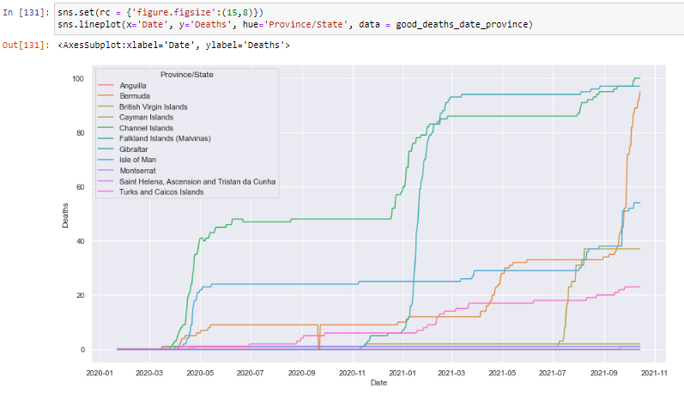
Notes:
Once I removed this State, the plot was showing up as I would expect it to. Although lines aren’t smooth

Slide 28
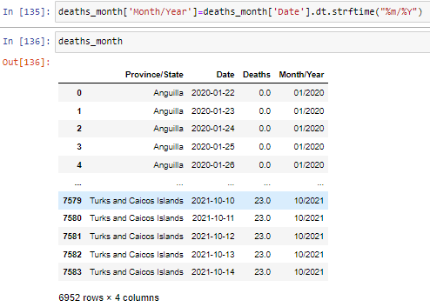
Notes:
By converting the dates to months/year, I was able to further improve on this visualisation with smooth lines now

Slide 29
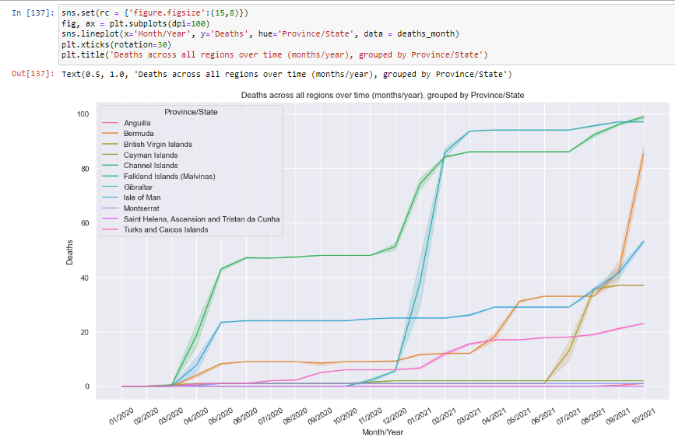
Notes:
Correct plot for Deaths over time

Slide 30
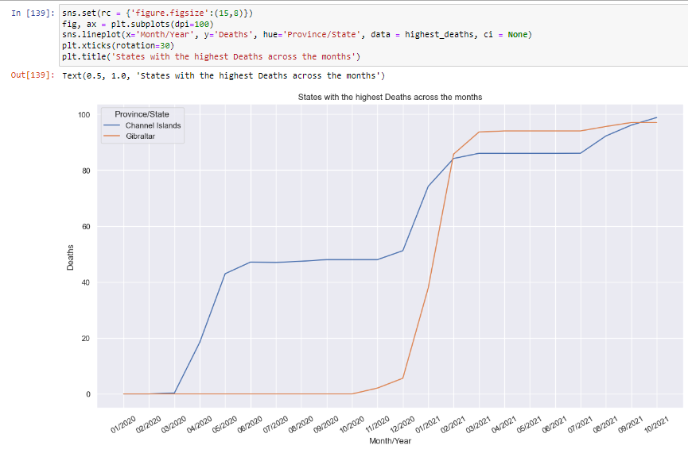
Notes:
Create a subset of the Deaths data to show the States with the highest Deaths over time; Channels Islands and Gibraltar. Falkland Islands had no death; another possible error that needs reviewing.

Slide 31
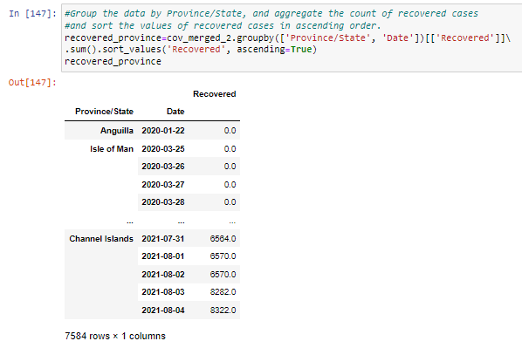
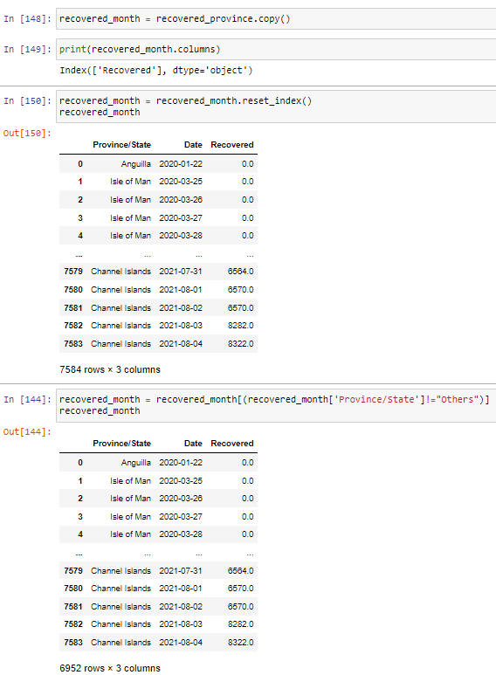
Notes:
Group the data by State and Date and show the sum of the recovered. Remove ‘Others’ State.

Slide 32
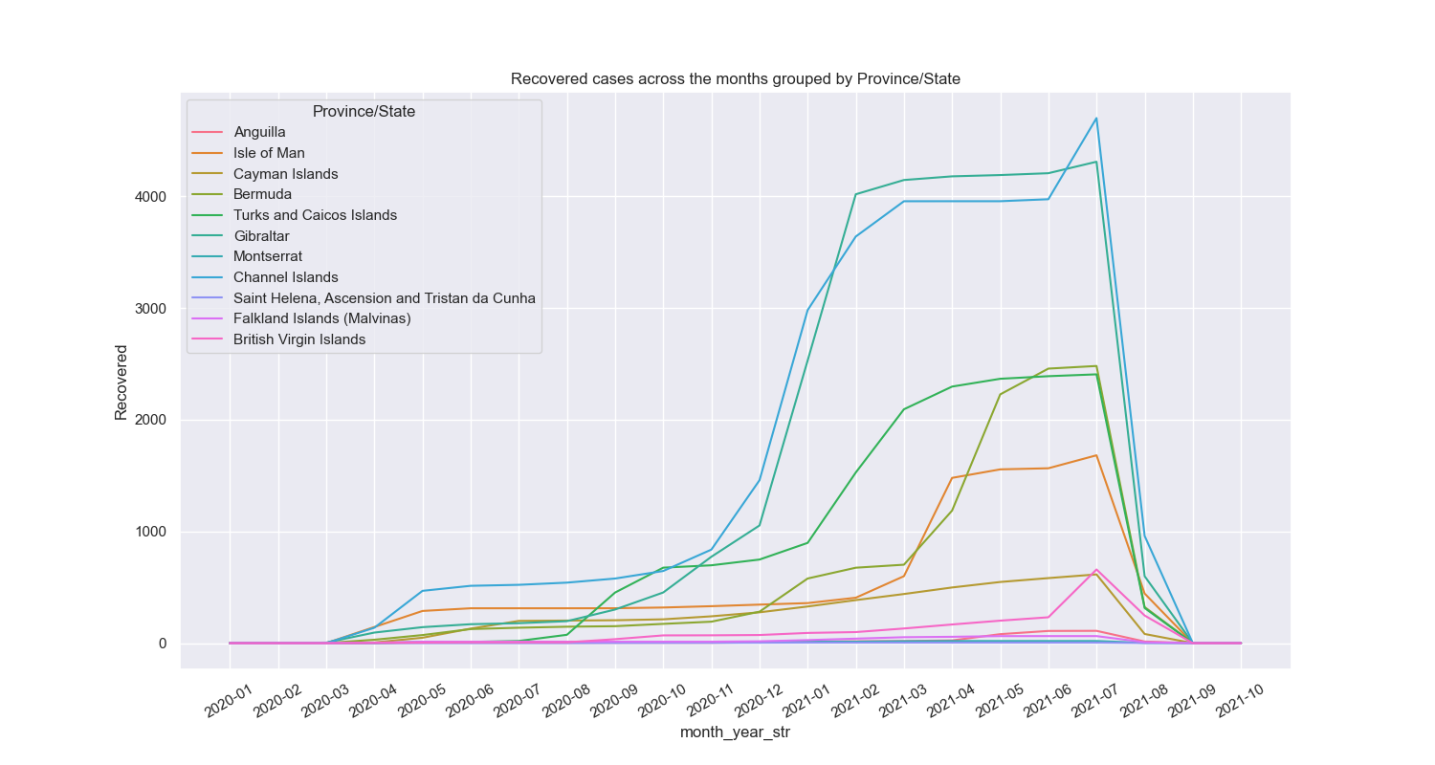
Notes:
Plot Recovered over time by Province/State. The Channel Islands had the highest number of recovered individuals over time, with Gibraltar briefly overtaking them from January 2021 to June 2021. Taking this information into consideration, the government could look to focus their vaccination drive at other regions where the recoveries is not so high.

Slide 33
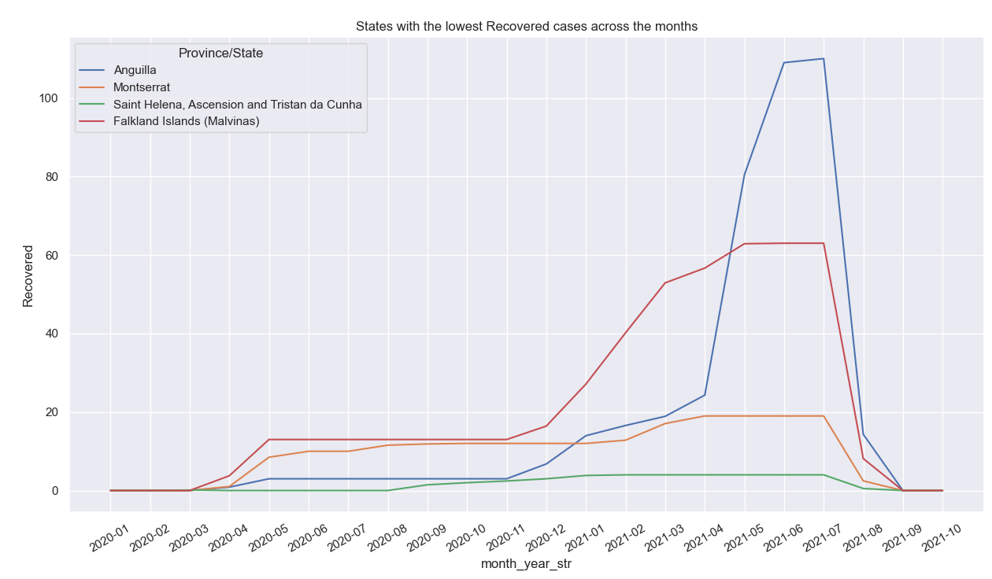
Notes:
States with the lowest recovered numbers over time

Slide 34
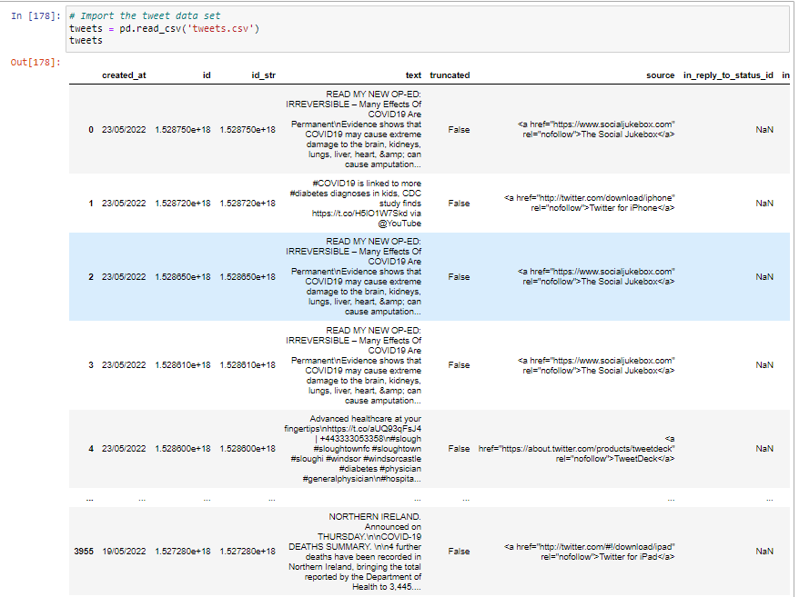
Notes:
Import tweets data

Slide 35
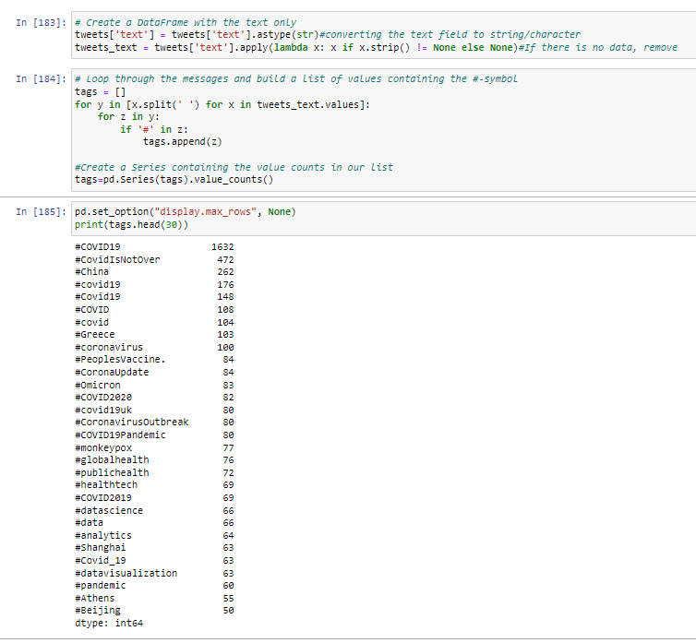
Notes:
Create a dataframe with the text only, then use a loop function to build a list of values containing the #. This will find all the hashtags used at the time. Show the top 30 Hashtags

Slide 36
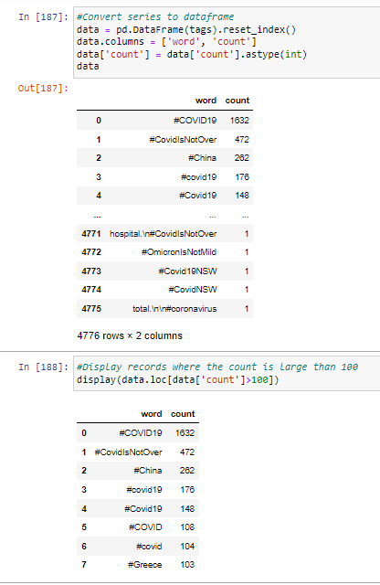
Notes:
Convert the pandas series into a dataframe and find the hashtags that were mentioned more than 100 times.

Slide 37
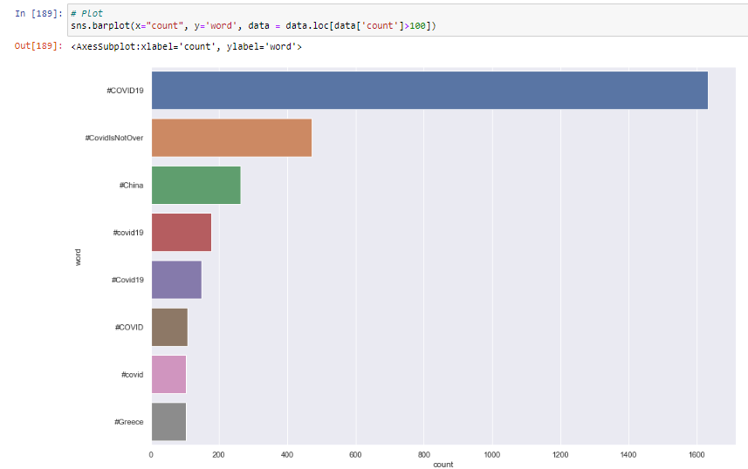
Notes:
Barplot for the top hashtags. #COVID19, #CovidIsNotOver and #China were the most common hashtags. This shows us our serious of a concern Covid was. You can see in the visualisation that 2 countries are in the plot; China and Greece. This is likely due to people tweeting about high covid cases in those countries at the time although we should investigate if these tweets are actually referring to covid.

Slide 38

Notes:
Code snippet to find all the tweets that contain the word China or Covid. You can see that not all the tweets are actually related to Covid. In social media, it is a tactic to get more hits by using the most popular hashtags at the time.

Slide 39
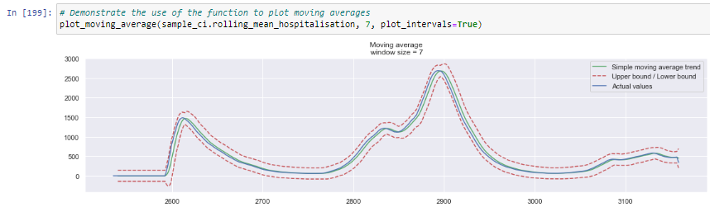
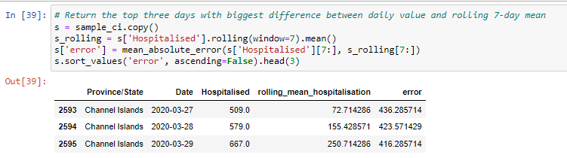
Notes:
A rolling average or a moving average is used to show trends over a short period of time using time data, where the trends would normally be difficult to detect. This is particularly the case when you have data where the numbers go up and down drastically and you would not normally see this change over time. The rolling average helps make it easier to visualise and interpret by smoothing the plots by a specified number of days (in this case the window is 7 days). The code snippet below helps us realise just how big the jump in hospitalisations is for these dates.

Slide 40
Conclusions
There are certainly some concerns relating to the integrity of the data.
Despite these we were able to draw some interesting trends and insights
Number of vaccinations is going down, after an initial increase. We have identified the States that have the highest percentage in terms receiving the first dose but not the second dose; these States are an easy target for the government in the first instance to boost vaccination numbers.
Notes:
Saint Helena, Ascension and Tristan da Cunha

Slide 41
Conclusions
Deaths were increasing for all States and for some it looked as though the peak hadn’t been reached yet.
Recoveries also increasing over time and I was able to identify the States with the highest and lowest recoveries.
The government can focus initially at the States with lower recovery numbers to boost vaccination numbers
Notes:
Again Saint Helena, Ascension and Tristan da Cunha.

Slide 42
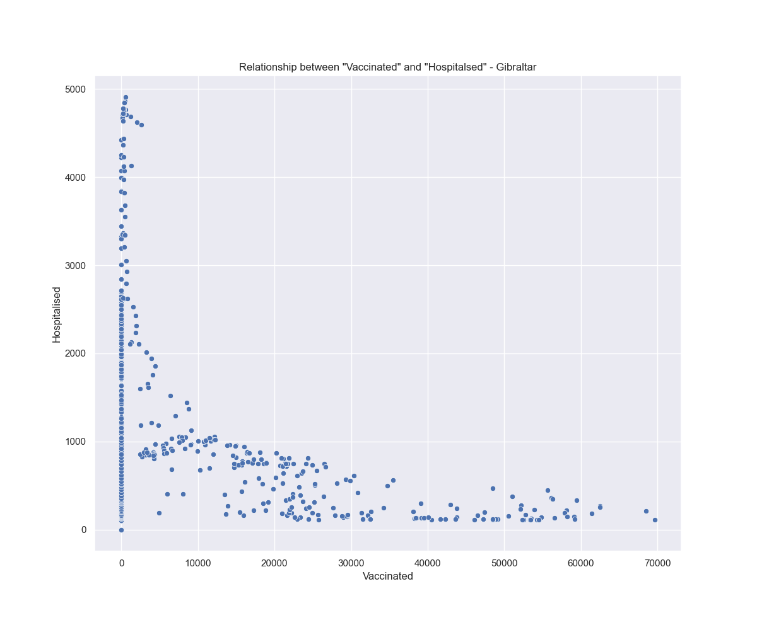
Notes:
This is important as it helps to portray the positive effect of vaccines and in turn it will help reduce the burden on the NHS; this’ll be a big plus point for the government.

Slide 43
Conclusions
To further the analysis, it would be useful to have population data available for all States. This would help us to interpret which State’s actually had the best/worst vaccination uptake rates and also how serious the covid rates (deaths, hospitalisations, recovered) were.

